Slide 1
Smart farming
Application of Digitally enabled Smart Farming Practices to Green house initiatives.

Slide 2
Project by:
Anuj C (18bcs009)
Jagadeesh C (18bcs033)
Arun Kumar S M (18bcs013)
Darshan R P (18bcs023)
Project guide
Dr. Uma Sheshadri

Slide 3
overview
The main objective of this project is to give the user(farmer) ability to access temperature and humidity of their nursery from anywhere.
Things used In this project:
Dht11 – is a sensor used to collect temperature and humidity data
Arduino Uno - microcontroller board based on the ATmega328P
Esp8266 – WIFI module
Android studio – to develop/create android application
Firebase – to store user login information
Thingspeak – server to store the values provided by the sensors

Slide 4
How It works
First, dht11 sensor will read the temperature and humidity data
The data collected by the sensor sent to thingspeak server using Arduino and esp8266
From thing speak the data will be retrieved by the android app
User will be notified by notification, if the temperature exceeds the limits.

Slide 5
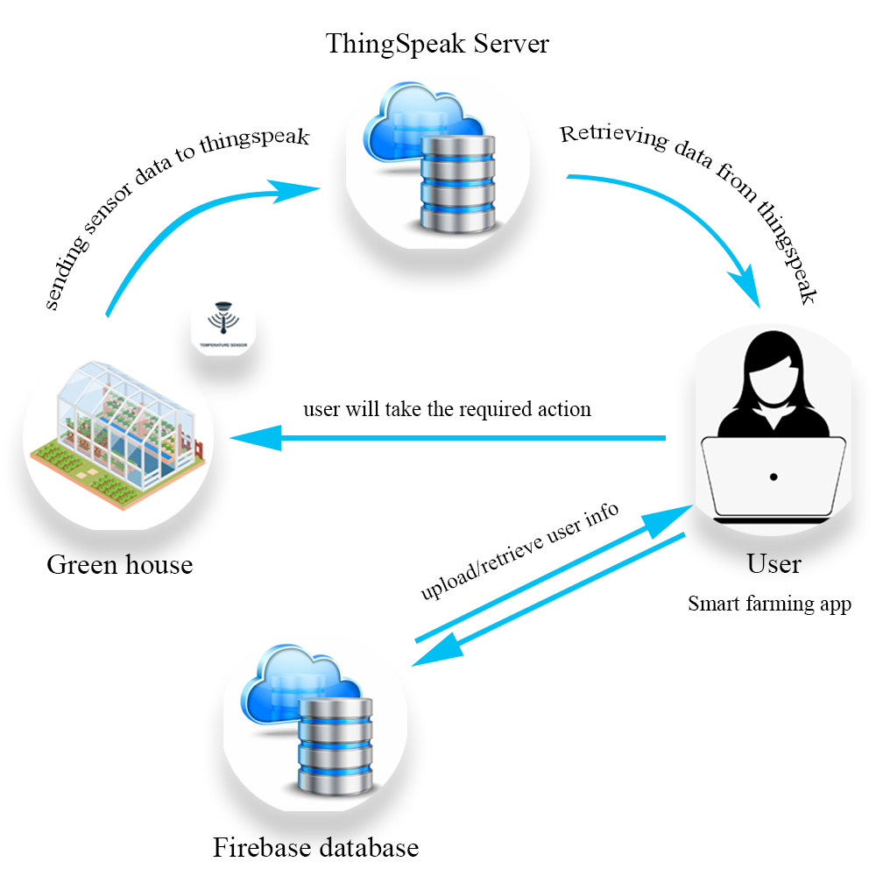

Slide 6
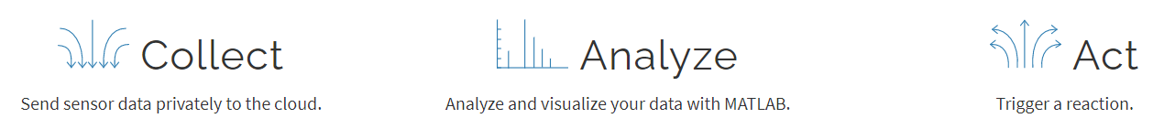
Thingspeak cloud
ThingSpeak is an IoT analytics platform service that allows you to aggregate, visualize and analyze live data streams in the cloud. ThingSpeak provides instant visualizations of data posted by your devices to ThingSpeak.
According to its developers, “ThingSpeak is an open-source Internet of Things application and API to store and retrieve data from things using the HTTP and MQTT protocol over the Internet or via a Local Area Network
https://thingspeak.com/pages/learn_more

Slide 7
How to use thingspeak
In order to use thinkspeak cloud we are required to create an account, channel and channel fields
Channel – a channel is where you send your data to store.
Channel field – Each channel includes 8 fields for any type of data.
Once you have a ThingSpeak Channel you publish data to the channel, have ThingSpeak process the data, then have your application retrieve the data.

Slide 8
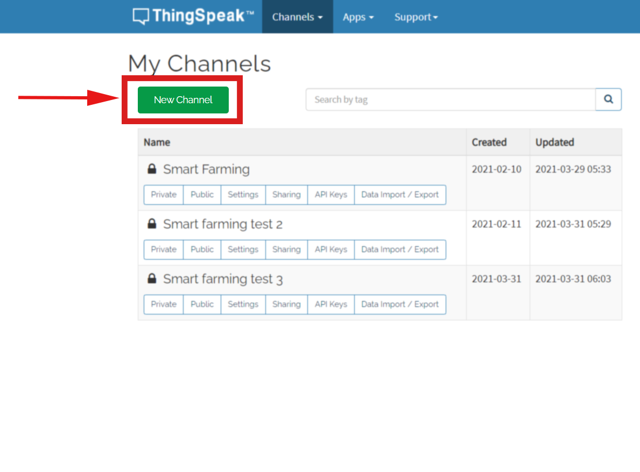
After login, click on new channel

Slide 9
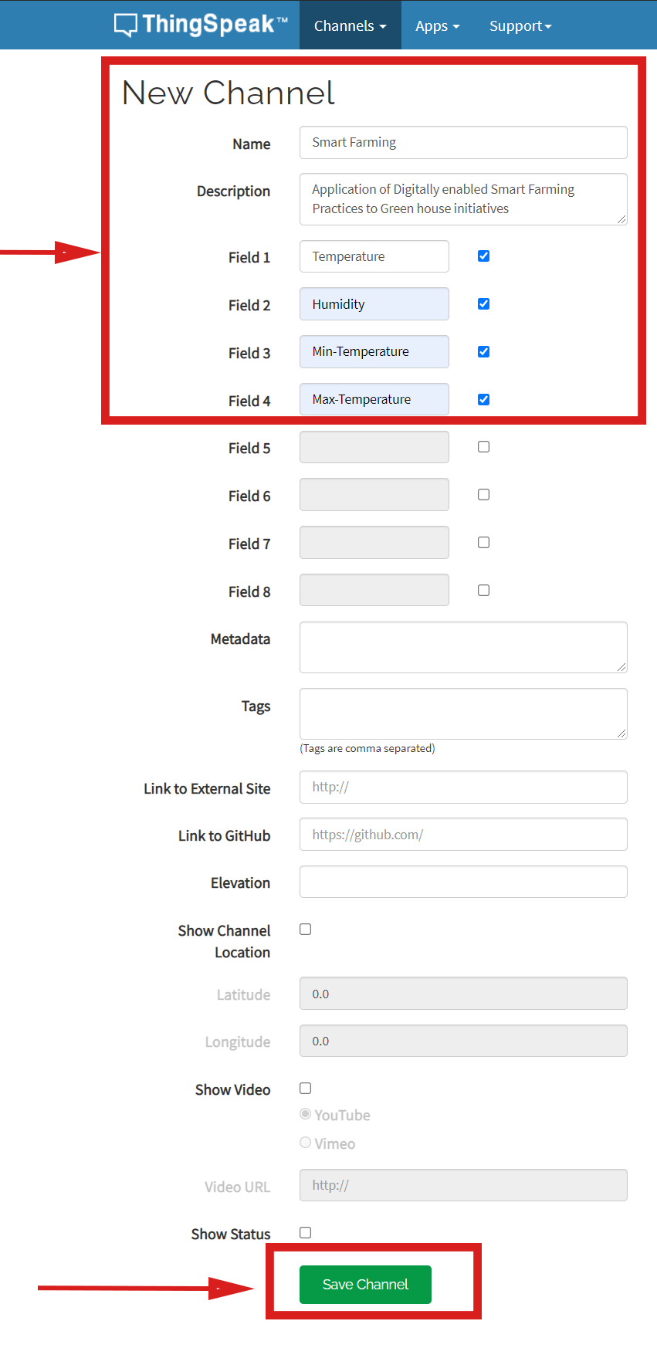
Then, give name of the channel, description
And create 4 fields for
Temperature
Humidity
min-temperature limit
Max-temperature limit
Save channel

Slide 10
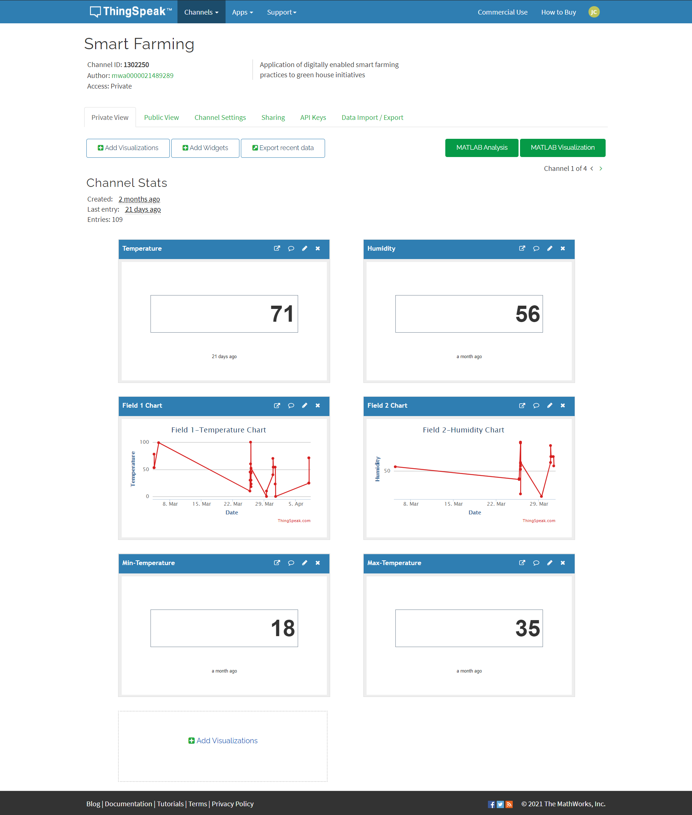
HOME PAGE
HOME PAGE WILL SHOW YOU THE REAL TIME VALUES OF FIELDS THAT BEEN CREATED
IF NOT SHOWING GO TO ADD VISUALIZATION OR ADD WIDGETS TO ADD VISUALIZER OR NUMERIC DISPLAY, LAMP INDICATOR GAUGE.

Slide 11
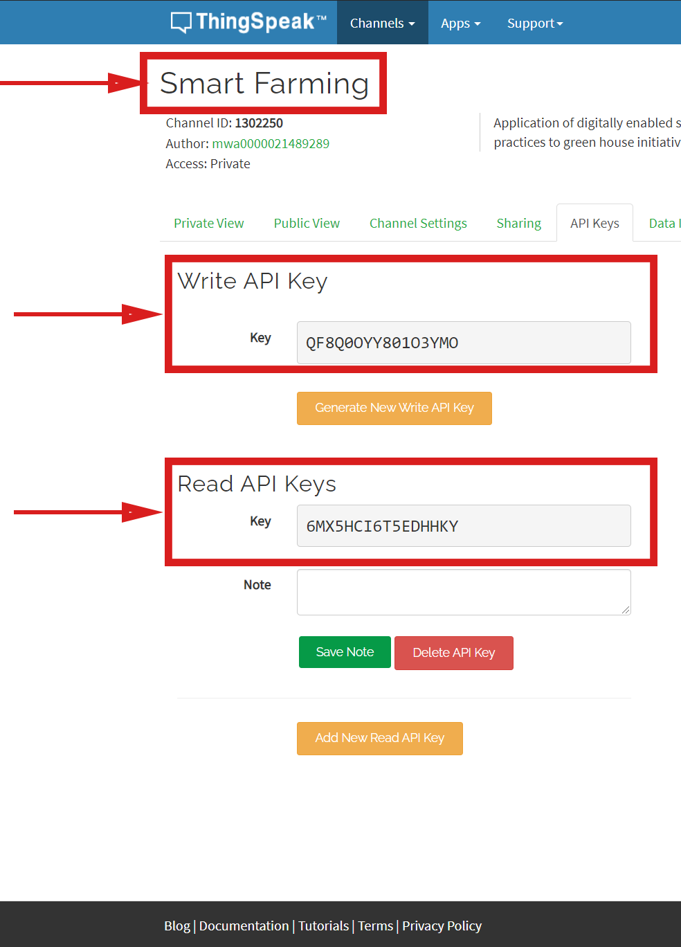
API KEYS
GO TO API KEYS SECTION
API SECTION HAS CHANNEL ID, WRITE API KEY, READ API KEYS.
THESE KEYS ARE USED TO MODIFY ANY FIELD VALUES
WRITE API – TO WRITE VALUE TO A FIELD
READ API – TO READ VALUE FROM A FIELD
THESE KEYS ARE LATER USED TO CREATE AN ACCOUNT IN SMART FARMING ANDROID APP

Slide 12
About android app
Smart farming app has been developed/created using android studio and uses firebase database to store user login information.
It retrieves data from thingspeak cloud, which contains temperature and humidity data updated by sensor.
As it retrieves data via internet, user can retrieve the data from anywhere

Slide 13
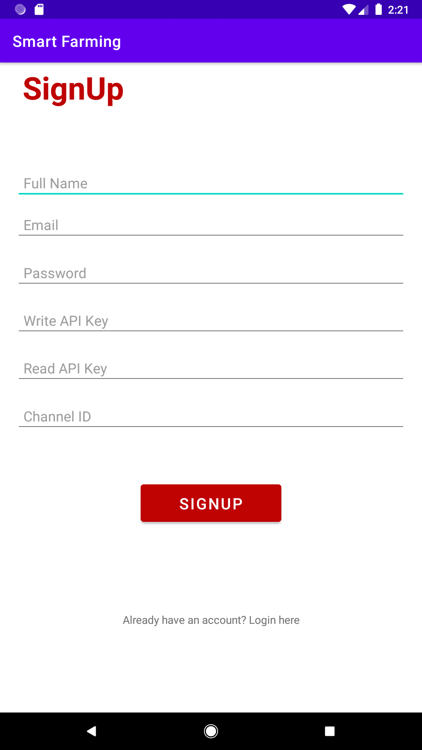
Sign-up
User required to fill all the fields provided in the sign-up page
Name, email, password, write api key, read api key, channel id
User need to verify their email by clicking the link sent to their email
Fill the api keys obtained from thingspeak and click sign-up
All the information provided will be stored in firebase
Then it will take the user to the login page.

Slide 14
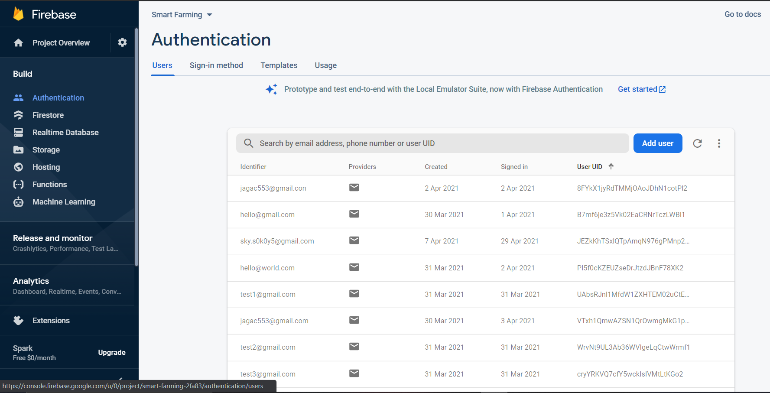
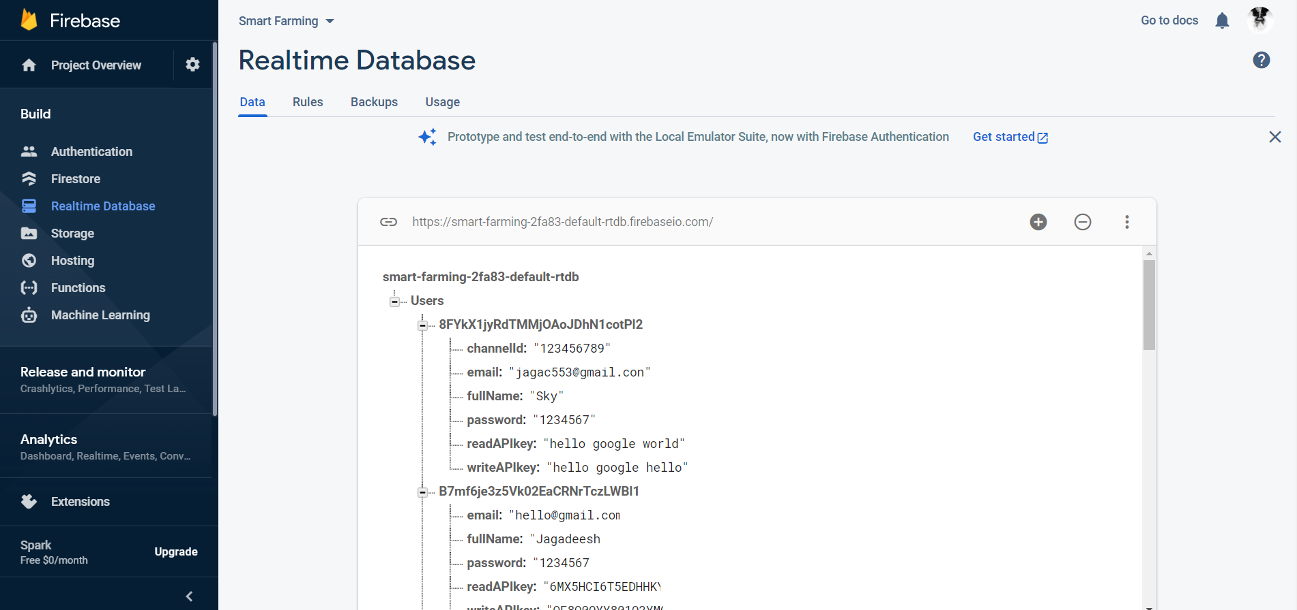
Firebase
Firebase is a platform developed by Google for creating mobile and web applications.
Firebase provides up to 1GB Storage for free on Firestore, the latest Google realtime database. After exhausting the free storage, users will pay for storage space and database operations
User details stored in firebase

Slide 15
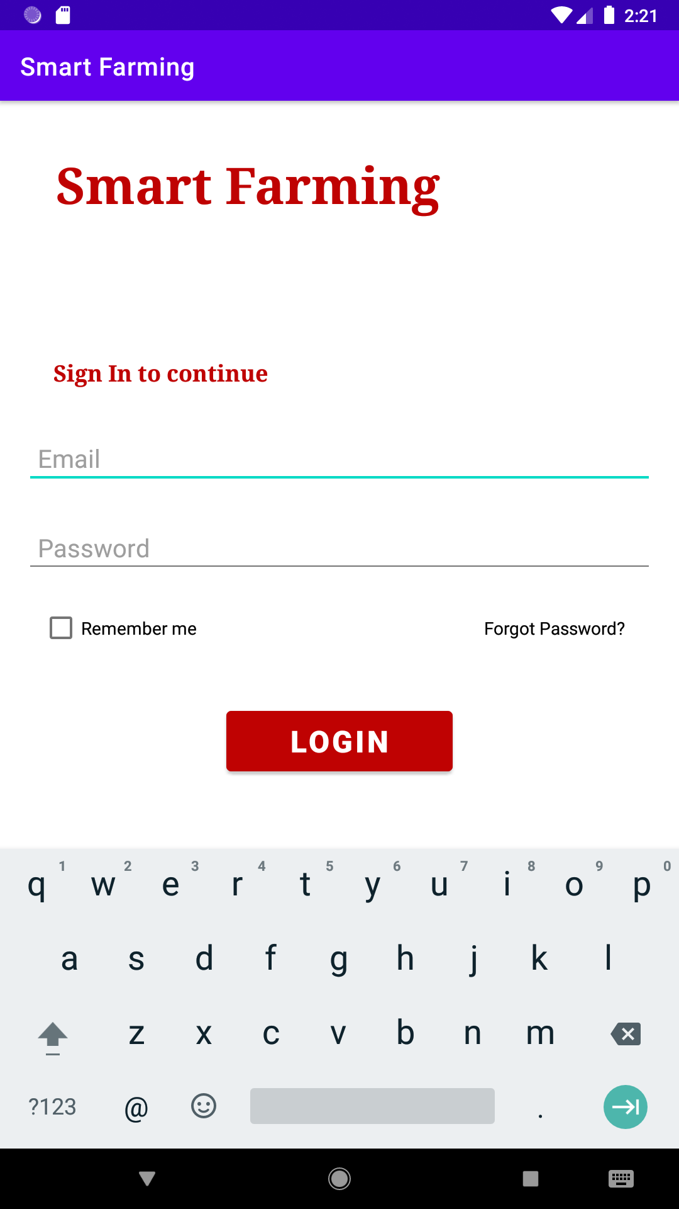
login
User need to provide their email and password used while creating the account
Email need to verified in order to login
In case, If the user forgot their password, they can reset the password using “forgot option”, which sends an email to reset their password
remember option used to remember the user.
If the credentials provided are correct then the user will taken to the home page

Slide 16
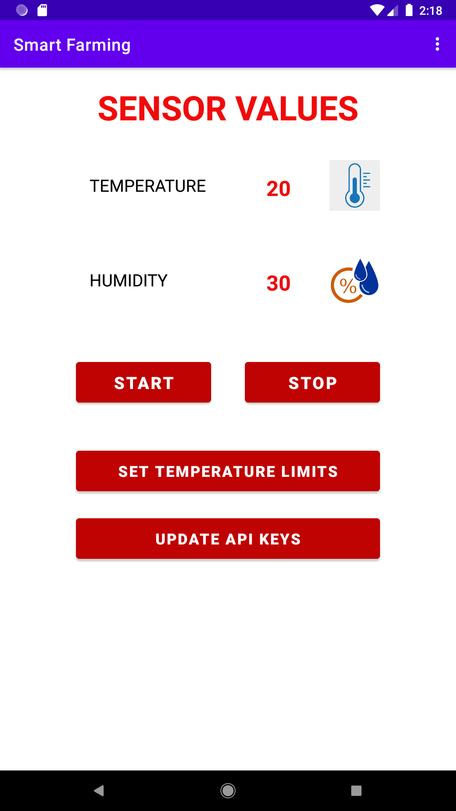
Home page
Home page displays the temperature and humidity values
App will start reading the temperature and humidity data continuously from thingspeak field1 and 2, once the user clicks start button
And the app will stop when the user clicks stop button
Set temperature limits and update api keys buttons will take the user to their respective pages
User can logout using the logout button present in menu at upper right corner in the home page

Slide 17
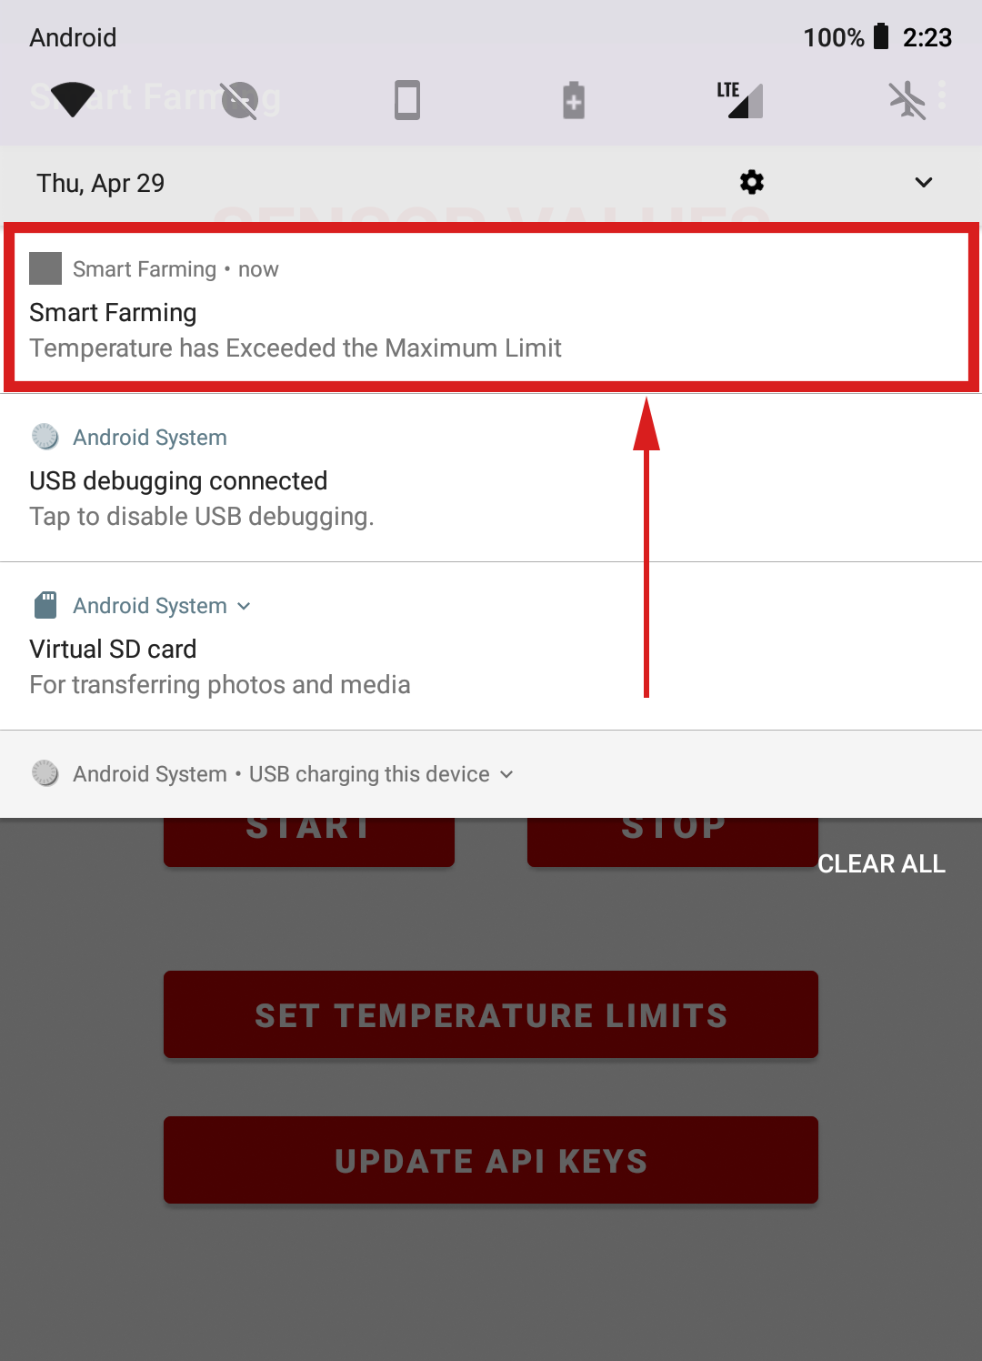
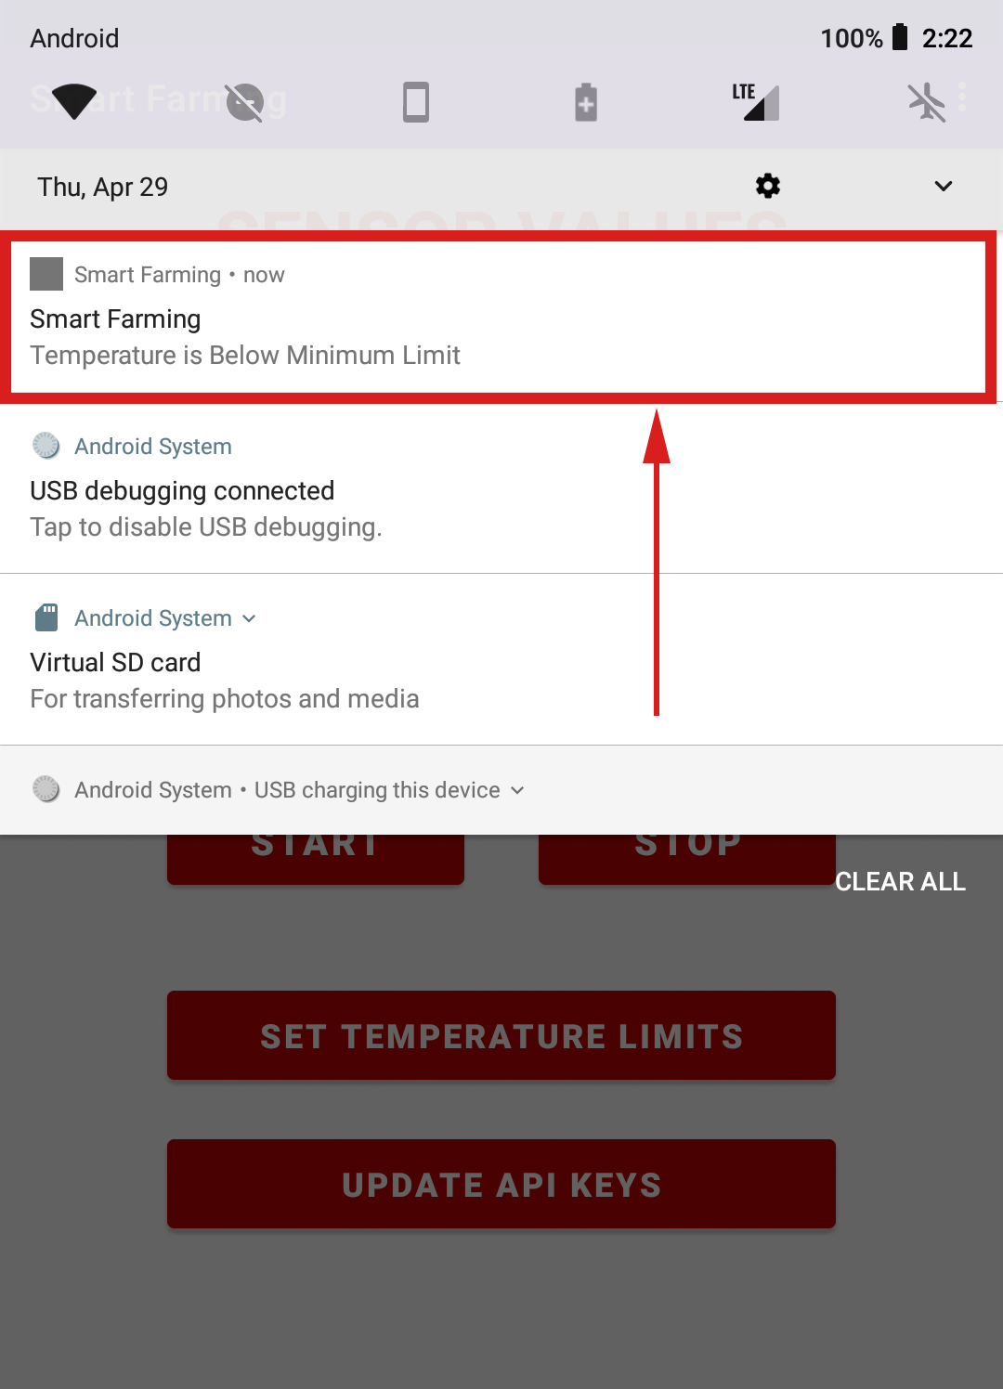
notification
User will be notified by notification if the temperature limit goes below minimum temperature limit or beyond maximum temperature limit.

Slide 18
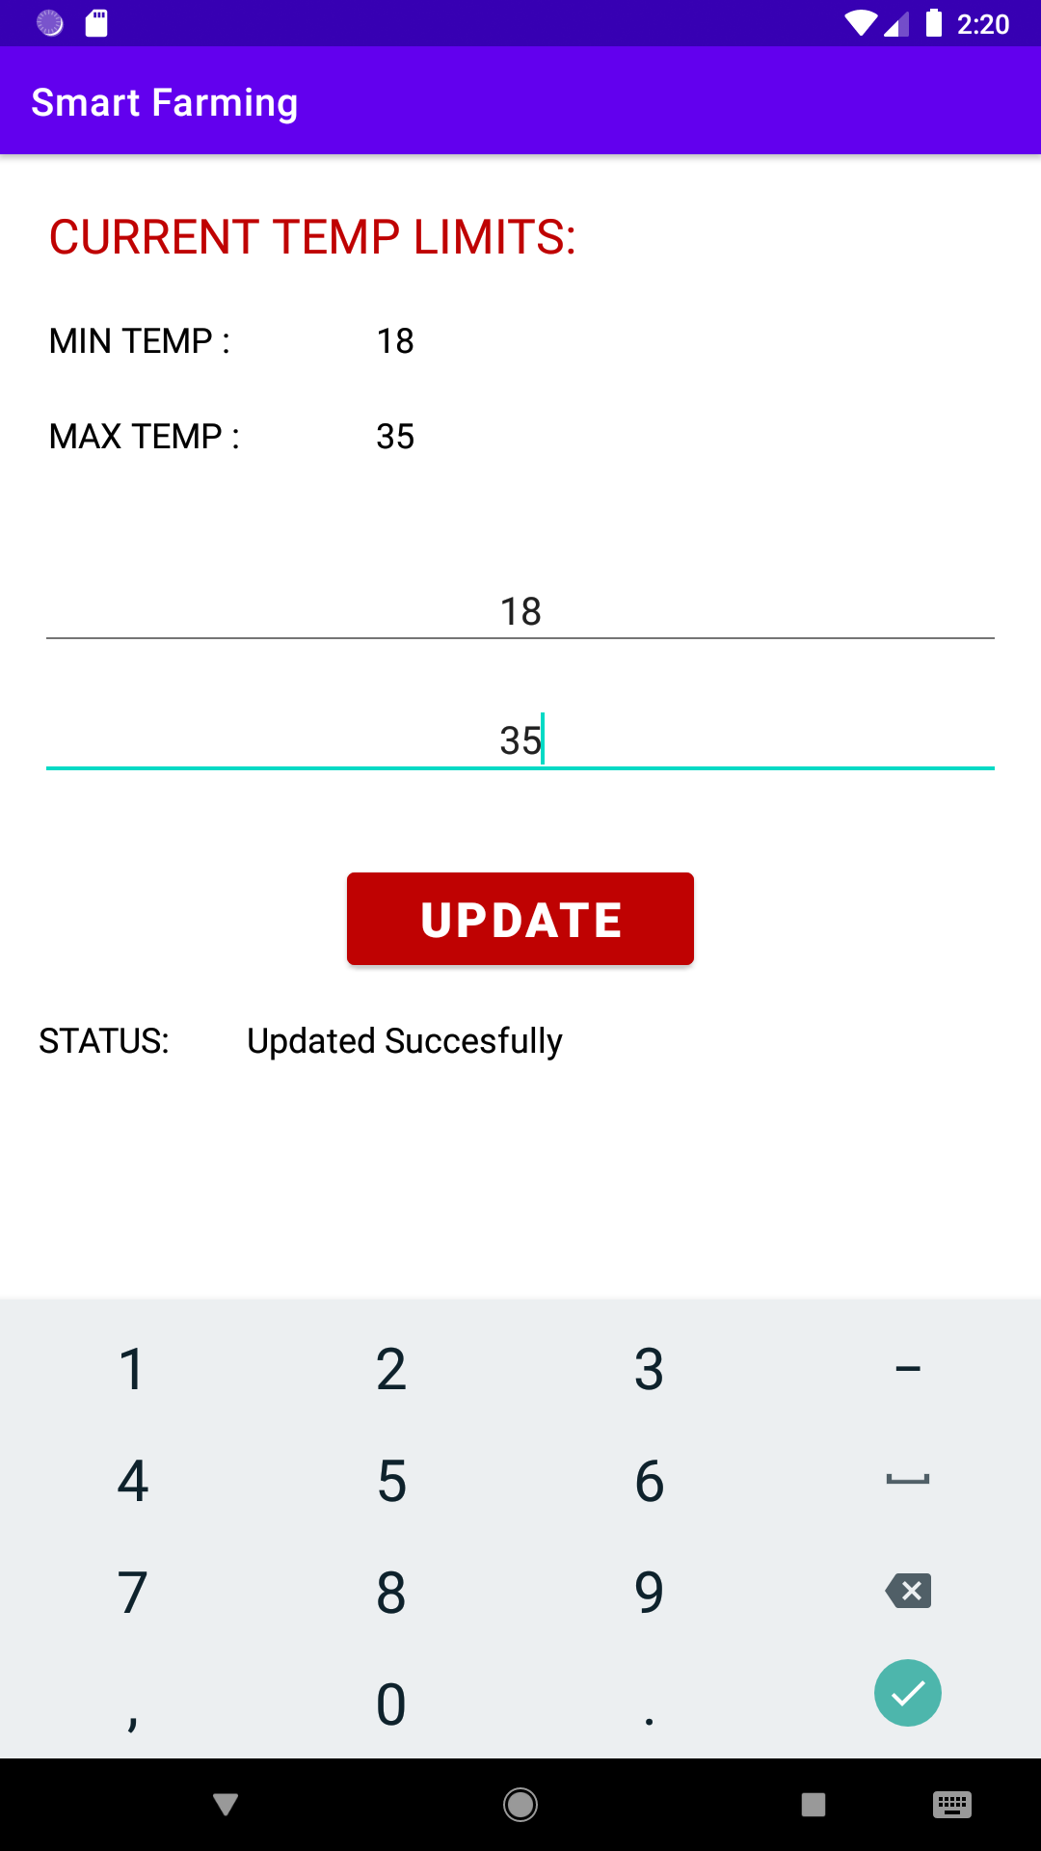
Temperature limits
User can set the maximum and minimum temperature limit by clicking “set temperature limits” button in home page which takes user to the page shown in the image
Minimum and maximum limit is updated in thingspeak field3 and 4.

Slide 19
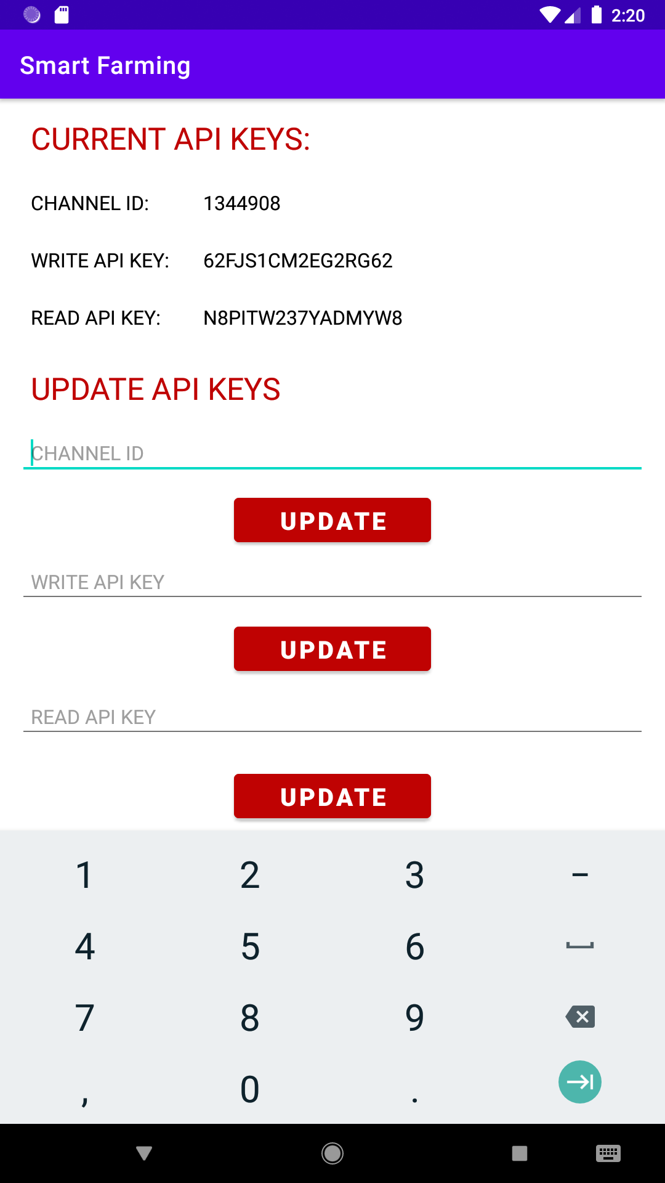
Api keys
User can also update the api keys by clicking “update api keys” button in home page which takes user to the page shown in the image
Here user can update the channel id, write api key, read api key.

Slide 20
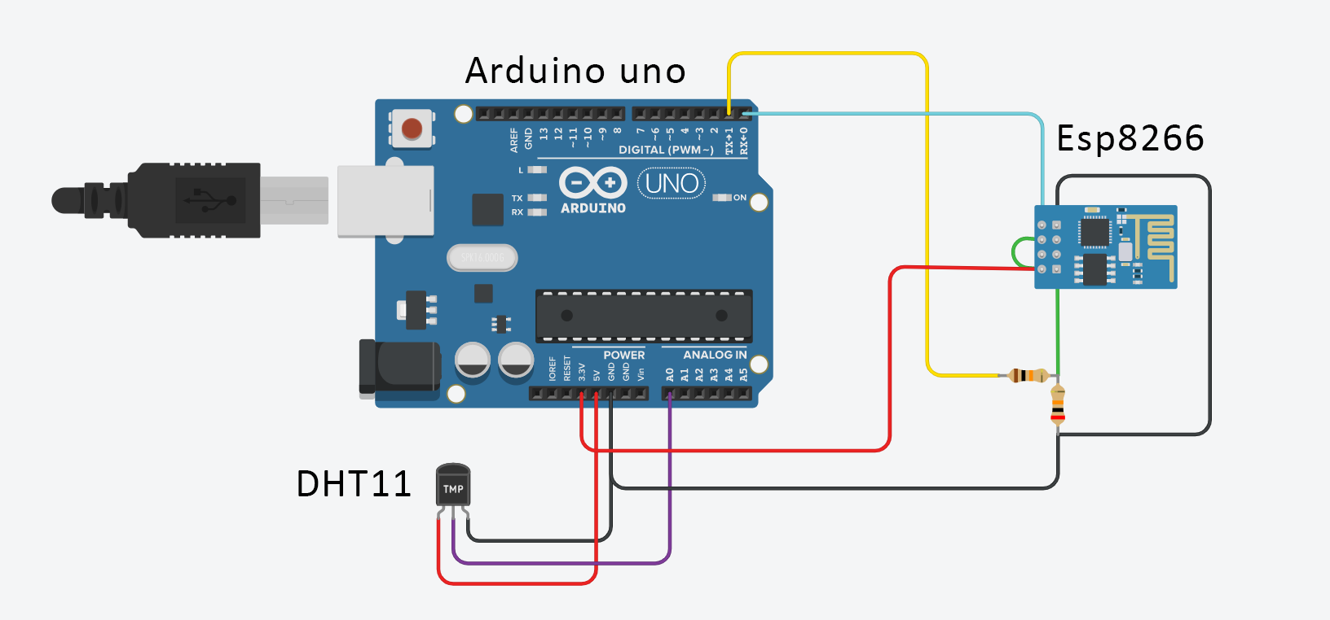
Circuit diagram
Esp8266 works on 3.3v, 5v will burn the module

